Slide 1

Introduction to Web Application Penetration Testing
By: Rana Khalil

Slide 2
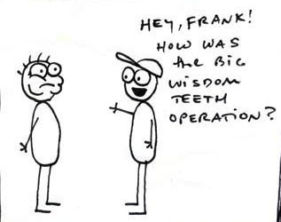
Who am I?
University of Ottawa student – Master of Computer Science
Thesis: Comparative Analysis of Open-source Web Application Vulnerability Scanners
Previous work experience include: Software developer, Tester, Ransomware researcher, Security Analyst.
Aspiring Ethical Hacker!
Removed my wisdom tooth a week ago ☹
Notes:
Pic taken from: http://caseythecollegeceliac.blogspot.com/2014/05/celiac-and-wisdom-teeth-part-1.html

Slide 3
Outline
Introduction to web application penetration testing
Software setup
Mapping and analyzing the application
Bypassing client-side controls
Attacking authentication
Attacking session management
Attacking data stores

Slide 4

The web application hacker’s handbook
Bible of web application penetration testing.
Good mix of theory and practice.
Most of the examples in the slides are from this book.

Slide 5






Tools needed for workshop
Burp Community Edition
OWASP ZAP
VirtualBox
OWASP BWA Project
FoxyProxy Standard
Modern browser (preferably Firefox)
Note: You should have these tools already installed. An email was sent to registered participants prior to workshop.

Slide 6
INTRODUCTION
SECTION 1

Slide 7
Why the web?
Let’s look at some statistics:
Over 3.9 billion internet users in the world
Over 1.9 billion websites online
We use websites for everything: e-commerce, online banking to social networking, social media, etc.
Web security has become a major concern for businesses.
Recent example: Equifax. The breach exposed the personal information of 143 million US users and an estimated 100,000 Canadian users.
According to Trustwave’s 2018 Global Security Report:
100% of the web applications scanned by Trustwave displayed at least one vulnerability.
Median number of 11 vulnerabilities detected per application.

Slide 8
How to secure a web application?
Combination of techniques are used:
Secure coding practices
Web application firewalls
Static code analysis
Web application penetration testing
Etc.

Slide 9
What is web app pen testing?
Combination of manual and automated tests to identify vulnerabilities, security flaws and/or threats in a web application.
Categorized into three types:
White box: Tester has complete access and in-depth knowledge of the system. Access to source code is usually given.
Black box: Tester is given little to no information about the system. Just the URL of the application is usually given.
Grey box: Combination of white box and black box penetration testing. Limited information and access is given to the tester.
Several methodologies and guidelines: OWASP, PTES, PCI DSS, etc.
Most important thing to keep in mind: you need permission to perform a security test!

Slide 10
What is owasp?
Stands for Open Web Application Security Project
International open source community “dedicated to enabling organizations to conceive, develop, acquire, operate, and maintain applications that can be trusted”.
Contains widely used and popular tools such as the ZAP.
OWASP TOP 10 Project

Slide 11
Abstract pen testing Methodology
Reconnaissance
Mapping + Analyzing
Exploitation
Discovery

Slide 12
Software setup
SECTION 2

Slide 13
software SETUP
Download VirtualBox and OWASP BWA Project virtual machine.
Install OWASP BWA Project vm on VirtualBox.
Download Firefox and FoxyProxy add-on.
Download Burp Suite Community Edition and OWASP ZAP.
Configure Burp and ZAP in FoxyProxy.
Notes:
Download VirtualBox and OWASP BWA Project virtual machine.
VirtualBox: https://www.virtualbox.org/
OWASP BWA: https://sourceforge.net/projects/owaspbwa/
Install OWASP BWA Project vm on VirtualBox.
Sample installation instructions: https://www.utest.com/articles/installing-owasp-broken-web-applications-owasp-bwa-project
Download Firefox and FoxyProxy add-on.
Firefox: https://www.mozilla.org/en-US/firefox/new/
FoxyProxy: https://addons.mozilla.org/en-US/firefox/addon/foxyproxy-standard/
Download Burp Suite Community Edition and OWASP ZAP.
Burp Suite Community Edition (the free version): https://portswigger.net/burp
OWASP ZAP: https://www.zaproxy.org/
Configure Burp and ZAP in FoxyProxy.
Sample configuration instructions for ZAP: https://andrewedstrom.com/zap-foxyproxy/
Sample configuration instructions for Burp: https://nvisium.com/blog/2014/01/10/setting-up-burpsuite-with-firefox-and.html

Slide 14
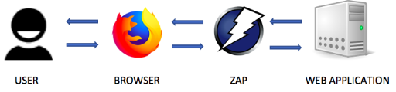
How does a proxy work?
Notes:
Any request sent by the browser will first be intercepted by zap and then sent to the web application. Similarly, any response sent by the web application will be intercepted by zap and then sent to the browser. When a request is intercepted, ZAP can modify the request to exploit an existing vulnerability in the web application.

Slide 15
Software setup
Setup Demonstration

Slide 16
Mapping and ANALYZING the application
SECTION 3

Slide 17
Mapping the application
Explore the visible content
Review public resources
Identify any hidden content

Slide 18
ANALYZING the application
Identify functionality
Identify data entry points
Identify the technologies used
Map the attack surface

Slide 19
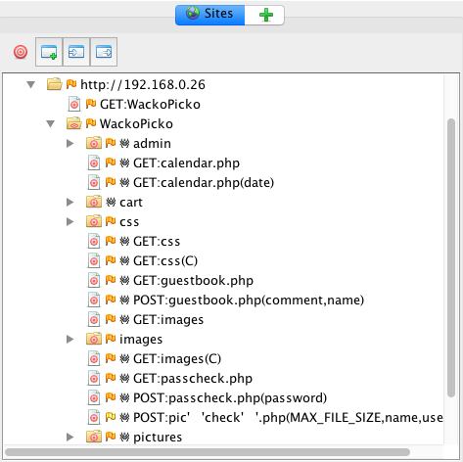
EXERCISE #1: WACKOPICKO
Web Spidering
Your goal is to use ZAP spider to crawl the application.
Configure browser to work with ZAP
Load the application on configured browser
Include root application URL in context.
Right click on the root URL in the Sites tree map > select Attack > select Spider.
Right click on the root URL in the Sites tree map > select Attack > select Ajax Spider.

Slide 20
EXERCISE #1: WACKOPICKO
Solution demonstration using ZAP and Burp Suite.

Slide 21
Bypassing Client-Side Controls
SECTION 4

Slide 22



Client-Side vs server-side validation
Client-side
Server-side
3
2
3
1
1
2

Slide 23
Bypassing Client-Side Controls
Allowing clients to submit arbitrary input is a core security problem in web applications.
Users have full control of everything submitted from the client.
Can cause a range of problems including corrupting data stores, allowing unauthorized access to users and buffer overflows.
In general, there are two ways client-side controls are used to restrict user input:
Transmitting data via the client using mechanisms that “prevent” user interaction. Examples include hidden form fields, disabled elements, referrer header, URL parameters, etc.
Controlling user input using measures that “restrict” user input. Examples include HTML form features, client-side scripts, etc.

Slide 24
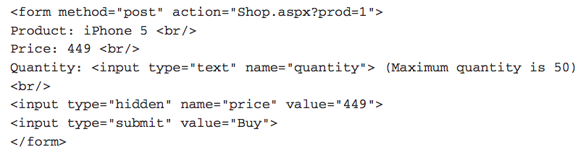
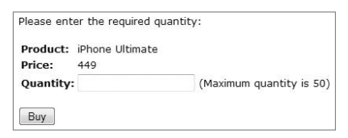
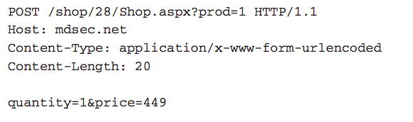
Transmitting data via the client
Example #1: Hidden Form Field
Code
Request

Slide 25
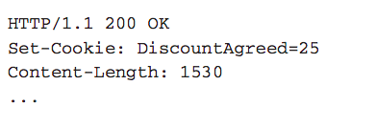
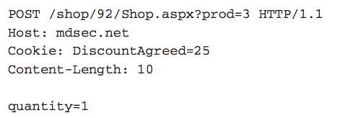
Transmitting data via the client
Example #2: HTTP Cookies
Response: Request:

Slide 26
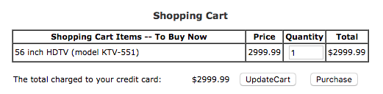
exercise #2: WEBGOAT
Exploit Hidden Fields
Try to purchase the HDTV for less than the purchase price, if you have not done so already.
Notes:
In order to change the price value, click on Purchase button and intercept the request using Burp Proxy. In the intercepted request, you’ll see that the price field is sent to the server as a parameter when the form is submitted. Change the price value to the desired value and forward the request by clicking on the Forward button in Burp. The application will successfully process the transaction with the chosen price value.

Slide 27
exercise #2: WEBGOAT
Solution Demonstration

Slide 28
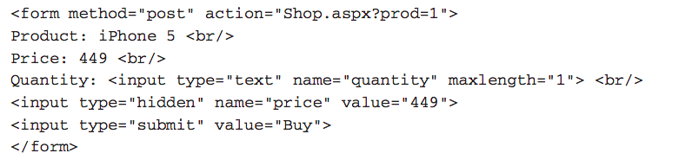
restricting USER DATA
Example #3: Length Limits

Slide 29
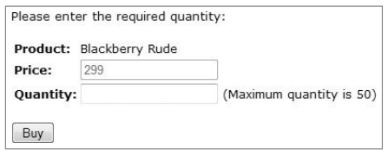
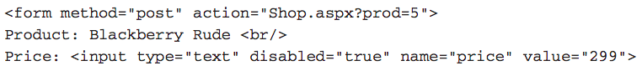
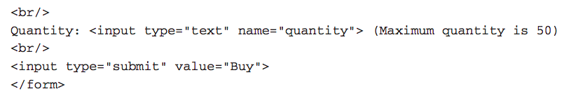
restricting USER DATA
Example #4: Disabled Elements

Slide 30
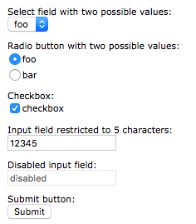
exercise #3: WEBGOAT
Bypass HTML Field Restrictions
You must submit invalid values for all six fields in one form submission.
Notes:
The following form has field restrictions on each input field. Our goal is to submit this form with each field containing a value that would otherwise be rejected on the client side. Similar to example 2, intercept the request and modify every value.

Slide 31
exercise #3: WEBGOAT
Solution Demonstration

Slide 32
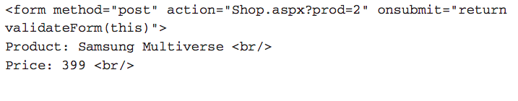
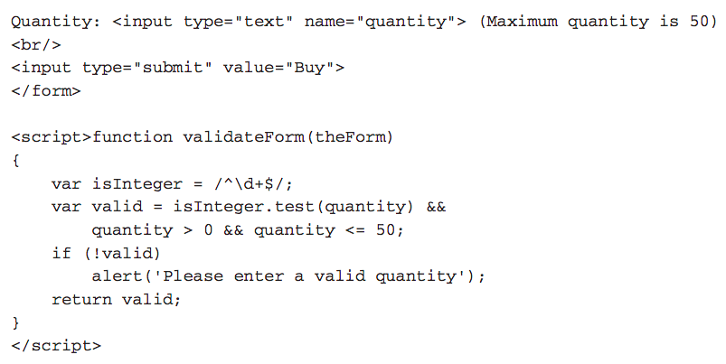
restricting USER DATA
Example #5: Script-Based Validation

Slide 33
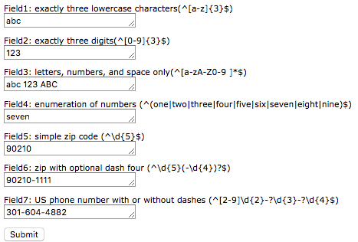
exercise #4: WEBGOAT
Bypass Client Side JavaScript Validation
You must break all 7 validators at the same time.
Notes:
Solution similar to example 2 and 3.

Slide 34
exercise #4: WEBGOAT
Solution Demonstration

Slide 35
Attacking authentication
SECTION 5
Notes:
Most applications

Slide 36
authentication
Authentication is a mechanism for validating a user.
There are many authentication technologies:
HTML forms-based authentication
Multifactor authentication
Client SSL certificates and/or smartcards
etc
In general, there are two factors that result in insecure authentication:
Design flaws in authentication mechanisms
Implementation flaws in authentication

Slide 37
Design flaws in authentication mechanisms
Bad passwords*
Brute-forcible logins
Verbose Failure messages
Vulnerable transmission of credentials
Weaknesses in password change functionality
Weaknesses in forgotten password functionality*
etc.

Slide 38
Bad passwords
Very short or blank passwords
Common dictionary words or names
The same as the username
Still set to the default value
Check the strength of your password:
https://password.kaspersky.com/

Slide 39
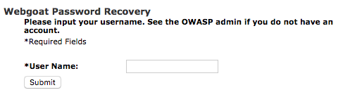
exercise #5: WEBGOAT
Forgot Password
The goal is to retrieve the password of another user.
Notes:
The goal of this exercise is to retrieve the password of another user. We’ll try to get the admin’s password. Try the username ‘admin’, You get directed to another page that contains the secret question which means the username ‘admin’ is a valid username. Now, enter any color in the answer field and intercept the request in Burp Suite. In the Intercept sub-tab of the proxy tab, right click anywhere on the request and select ‘Send to Intruder’. In the ‘Intruder’ tab, click the ‘Clear’ button to clear all payload markers and highlight the color you entered and click the ‘Add’ button. Switch to the ‘Payloads’ sub-tab and add all the colors under ‘Payloads Options [Simple List]’. Make sure that the proxy intercept is off. Switch back to the ‘Positions’ sub-tab and click on ‘Start Attack’. The color with the different payload size is the correct answer (in this case it is green).

Slide 40
exercise #5: WEBGOAT
Solution Demonstration

Slide 41
IMPLEMENTATION FLAWS IN AUTHENTICATION
Fail-open login mechanisms
Defects in multistage login mechanisms*
Assumption that access to a later stage means that the user cleared prior stages.
Trusting client side data across stages
Insecure storage of credentials
etc.

Slide 42
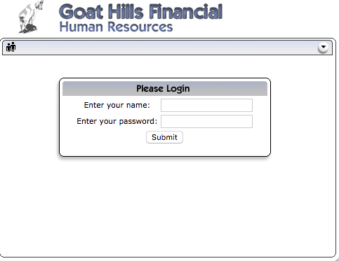
exercise #6: Webgoat
Multi Level Login 2
Your goal is to log in as Jane.
Notes:
Log in with the given username Joe and password banana. Enter a transaction number and intercept the request in Burp Suite. In the ‘Intercept’ sub-tab, change the parameter ‘hidden_user’ to ‘Jane’ and forward the request.

Slide 43
exercise #6: Webgoat
Solution Demonstration

Slide 44
Attacking session management
SECTION 6

Slide 45
Attacking session management
Understand the mechanism
Test session tokens for meaning
Test session tokens for predictability
Check for session termination

Slide 46
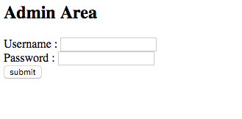
exercise #7: WACKOPICKO
Session Management
Try to determine how the session is being calculated for the admin interface. Log in as admin/admin multiple times to solve this exercise.
Notes:
Enter the username/password admin/admin and intercept the request in Burp Suite. In the ‘Intercept’ sub-tab under the ‘Proxy’ tab, right click anywhere on the request and select ‘Send to Sequencer’. In Sequencer tab, click the option ‘Start live capture’. This should give you an analysis of the statistical randomness of the session tokens. In our case, there is no statistical randomness, because the session cookies differ by 1.

Slide 47
exercise #7: WACKOPICKO
Solution Demonstration
Notes:
Burp sequencer

Slide 48
Attacking Data stores
SECTION 7

Slide 49
Attacking DATA STORES
Most applications have a data store to manage and store data.
User accounts, credentials and personal information.
Prices of items
Orders
Privilege level of a user
We’ll test for SQL injections.
Supply unexpected syntax that might cause problems in the application.
Identify and analyze any anomalies and error messages received.
Attempt to exploit the vulnerability

Slide 50
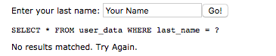
exercise #8: WEBGOAT
String SQL Injection
Try to inject an SQL string that results in all the credit card numbers being displayed. Try the user name of 'Smith'.
Notes:
To exploit the vulnerability enter the input Smith' or 'a' = 'a

Slide 51
exercise #8: WEBGOAT
Solution Demonstration

Slide 52
conclusion
SECTION 8

Slide 53

What next?
Concepts we learned today
Remaining concepts

Slide 54





What next?
Read books
Get a mentor
So many free online resource! (Cybrary, coursera, MIT open courseware, etc.)
Practice on intentionally vulnerable web applications
Participate in CTF competitions
Attend conferences
Contribute to open-source security projects
Apply to security jobs (Even if you don’t have all the qualifications. Most people don’t!)
Take life one step at a time. You can do this!

Slide 55




Get in Touch!
/ranakhalil1
https://rkhal101.github.io/
@rana__khalil
/rkhal101

Slide 56
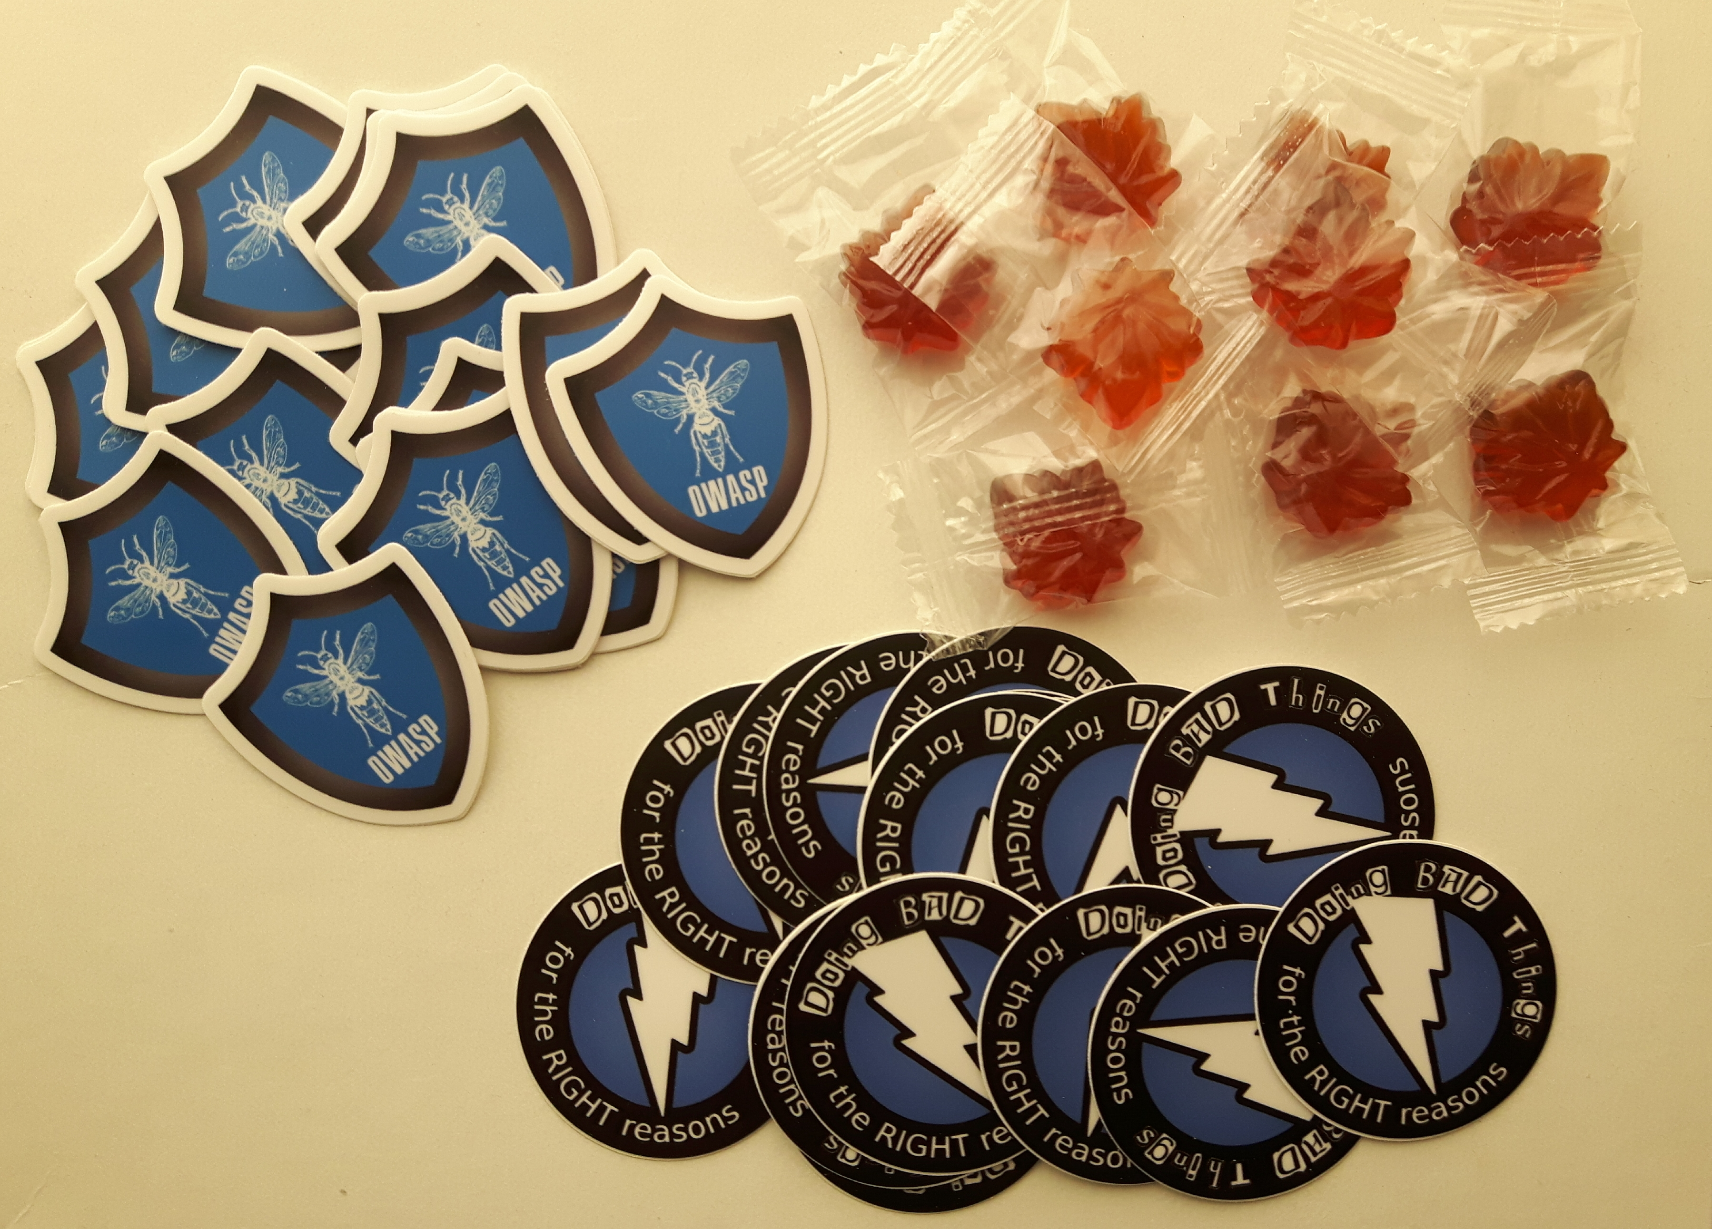
Get in Touch!
Laptop stickers generously donated by OWASP!

